Slide 1
2013 Telework Status
Report to Congress
Presenters:
Kimberly Wells, Ph.D.
Veronica Givens

Slide 2
Telework Report Sources
Data call
  Telework records from 90 Executive branch agencies (of 99 invited) and 179 subagencies
  Administered October 7 – December 7, 2012
  Results describe program implementation, employee eligibility and participation, and agency goals.
Federal Employee Viewpoint Survey
  Employee perspectives from a census survey of 82 agencies (97% of Executive branch); 46% response rate Governmentwide (1,622,375 employees invited).
  Survey administered April – June 2012
  Results describe the relationship between telework and employee attitudes and perspectives (e.g., job satisfaction, turnover intentions).
2
Notes:
2

Slide 3
2012 v. 2011 Telework Participation
 | 2012 |  | 2011
 | Number/ Percent of employees | Number of agencies responding | Number/ Percent of employees | Number of agencies responding
Total number of employees | 2,157,668 | 88 | 2,165,390 | 86
Employees deemed eligible to telework | 1,020,034 (47%) | 83 | 684,589 (32%) | 82
Eligible employees with telework agreements | 26% | 81 | 21% | 82
Eligible employees Teleworking in September | 21% | 79 | 25% | 87
Eligible employees Teleworking in Fiscal Year 2012 | 30% | 75 | -- | --

Slide 4
Telework Eligibility by Cabinet Agency

Slide 5
Participation of Eligible Employees in Cabinet Agencies

Slide 6
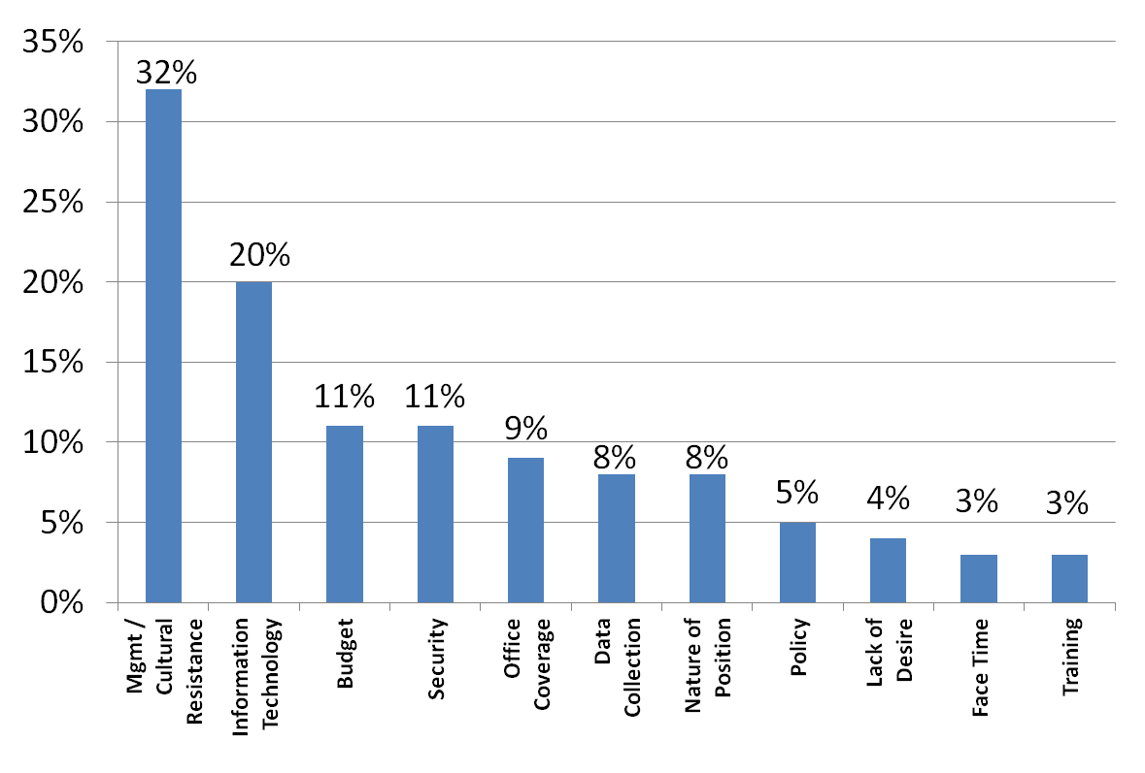
Barriers to
Participation

Slide 7
Telework Participation: FEVS

Slide 8
Promoting
Participation
In what ways has your agency's management promoted your telework program? | Number of agencies in 2011 | Number of agencies in 2012
Align telework with agency strategic goals and mission | 35 | 41
Advocate telework in agency-wide meetings (e.g., all-hands meetings) | 45 | 46
Use telework goal setting and measurement to hold managers accountable | 12 | 15
Emphasize telework as part of COOP (Continuity of Operations Plan) events | 66 | 68
Conduct special telework events (e.g., telework awareness weeks, telework drills) | 26 | 32
Transmit agency-wide emails of support | 40 | 43
Develop signs/posters | 13 | 16
Other | 25 | 32
Our agency has not taken action to specifically promote telework in the past year | 10 | 9

Slide 9
Telework Goals:
Cost Savings
 | Number of Agencies 2012 | Number of Agencies 2011
Reduced employee absences | 19 | 15
Human capital savings (e.g., retention) | 15 | 10
Reduced rent, office space | 13 | 6
Utilities Expenditure Savings | 10 | 4
Reduced Training Costs | 5 | 0
Reduced transportation subsidy | 4 | 4
Other | 22 | 23

Slide 10
Telework Goals:
Emergency Preparedness
77 agencies address telework in Continuity of Operations Plan
64 agencies address telework in Pandemic Influenza Plan
73 agencies include information about telework in emergencies as part of telework policy
41 agencies train teleworkers about what is expected of them in emergencies
15 agencies conduct telework exercises with all employees (up from 8 in 2011)
38 agencies test IT capacity for telework (up from 32 in 2011)

Slide 11
Telework and
Job Satisfaction

Slide 12
Telework and
Attracting New Workers

Slide 13
Next Data Call and Report
Data Call will be issued in later February 2014
Data for the 2014 report will be drawn from 2013 agency records and FEVS
Increased focus on goal setting and results of goal assessment

Slide 14
Questions?

